Slide 1
VIDEO SEGMENTATION CHALLENGE
Pooshan Shah, Teeru Gupta, Apoorva Reddy, Serena Du, Shan Qin

Slide 2
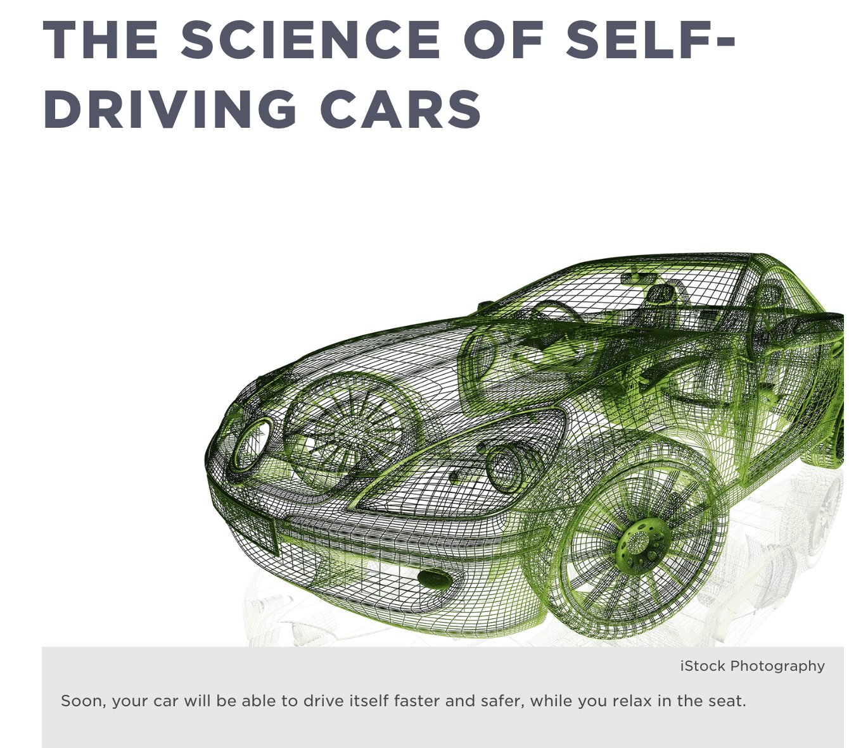
“Sensors for other features such as radar, ultrasonics, and cameras provide the input necessary to navigate the car safely.”
Source: https://www.fi.edu/science-of-selfdriving-cars
Notes:
An increasing number of applications in today’s world are gathering information from images. One such application is self-driving cars.
Found an article says that soon, your car will be able to drive itself faster and safer, while you relax in the seat. This can’t be achieved without the sensors. A sensor can be a camera, that provides the input necessary to navigate the car safely.

Slide 3
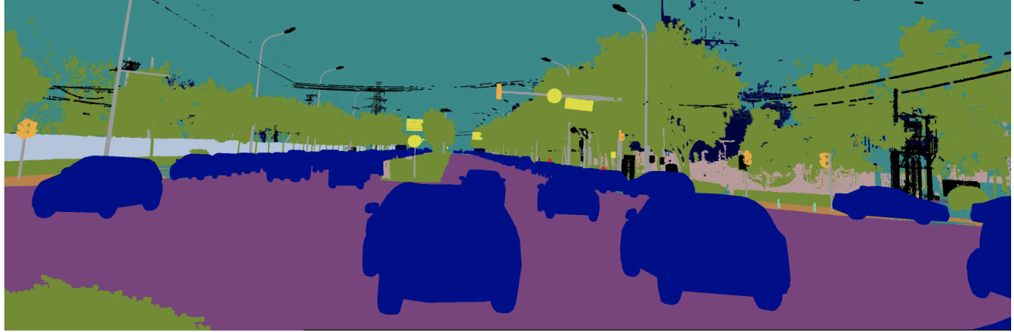
Problem Statement
Predicting segmentations of different movable objects appearing in the view of a car camera.
Notes:
Our team wishes to understand algorithms solving environmental perception problems for autonomous driving.

Slide 4
AGENDA
Background
EDA
Methodologies
Challenges

Slide 5
Dataset
96 GB of images data from Kaggle “CVPR 2018 WAD Video Segmentation Challenges”
94.1GB for train, 1.9 GB for test
41,139 images files from two camera angles
39,222 train images, 1,917 for test, all with a dimension of 3384 × 2710
33 classes, 7 interested classes for classification
car, motorcycle, bicycle, pedestrian, truck, bus, and tricycle
Notes:
convertVideotoCSV.py - an example script to convert images in a video clip into the CSV format
To work on the above problem we found a competition on Kaggle: CVPR 2018 WAD Video Segmentation Challenge.
The data, around 96 GB, consists of different movable objects appearing in the view of a car camera. We will use more than 39,000 images to train the network and 1900 images to evaluate how accurately the network learned to classify images.
The dataset comprises of image pairs where each input image is from footage of video driving scenes and the associated label is a corresponding image where each pixel value indicates the instance and class of an object. These images are 720p colored and labeled with 30+ classes. As per the competition, there are 92 GB pre-allocated for a training set, 4 GB for the test set

Slide 6
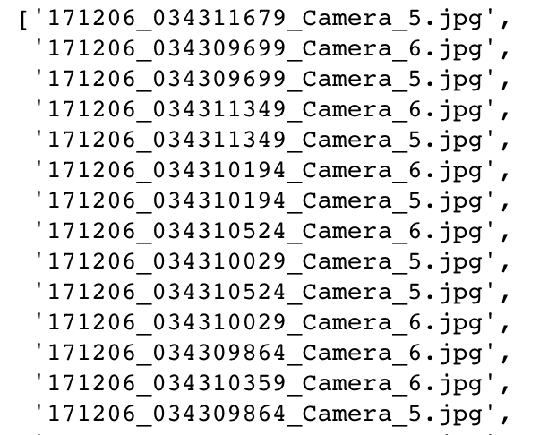
Training Data Structure
Train_color
Date
Frame Number
Camera
Train_label
Notes:
The prefixes of the files might represent dates the pictures were taken as in 170927 means year (20)17, month 9, and day 27. The middle string looks like it represents times and/or frame numbers. You can see that each instance from the middle set of numbers is listed twice - once for Camera 5 and once for Camera 6.

Slide 7
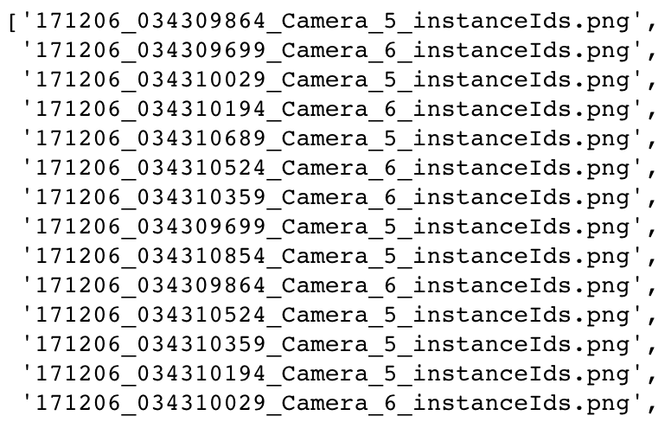
Training Data Structure
Train_color
Train_label
Grayscale encoded
Images

Slide 8
Understanding the training labels
Encoded in a format mixing spatial and label/instance information
Pixel values indicate both the label and the instance.
int(PixelValue / 1000) is the label (class of object)
PixelValue % 1000 is the instance id
*car: 33, bus: 39, tricycle: 40
Notes:
Remainder -- instance id
Each label could contain multiple object instances.
Instance 0: a pixel value of 33000 means it belongs to label 33 (a car)
Instance 1: a pixel value of 33001 means it also belongs to class 33 (a car)

Slide 9
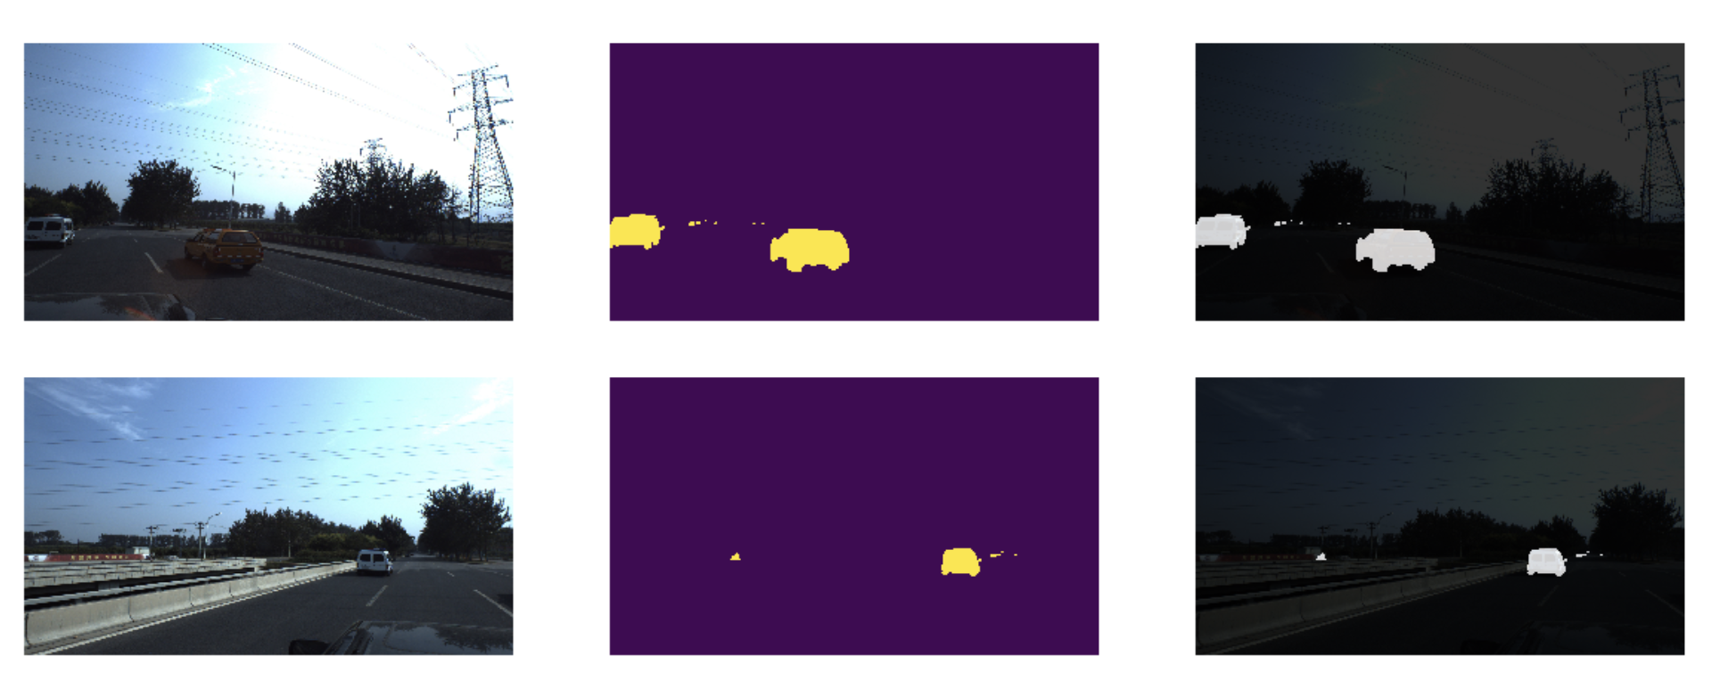
Training Data Structure
Color
Blended
Label
Notes:
What our training data looks like
Colored images
Label images

Slide 10
Exploratory Data Analysis

Slide 11
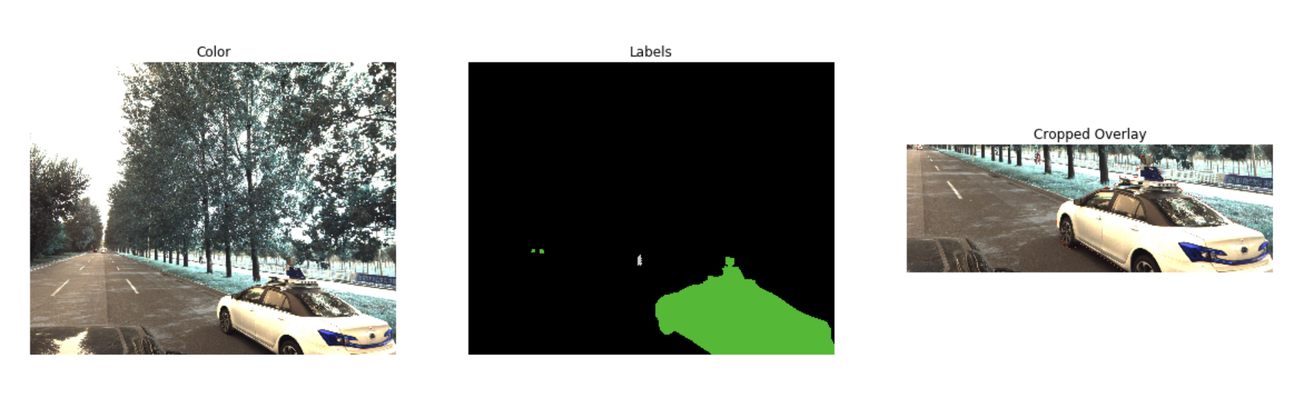
EDA: Training Data
Notes:
Cropped Overlay is what we are supposed to detect with the model

Slide 12
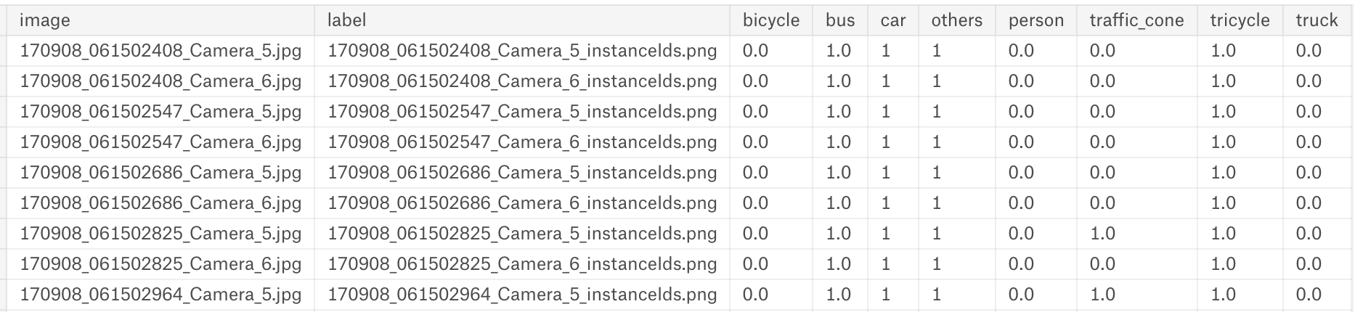
EDA: Objects in Training Images

Slide 13
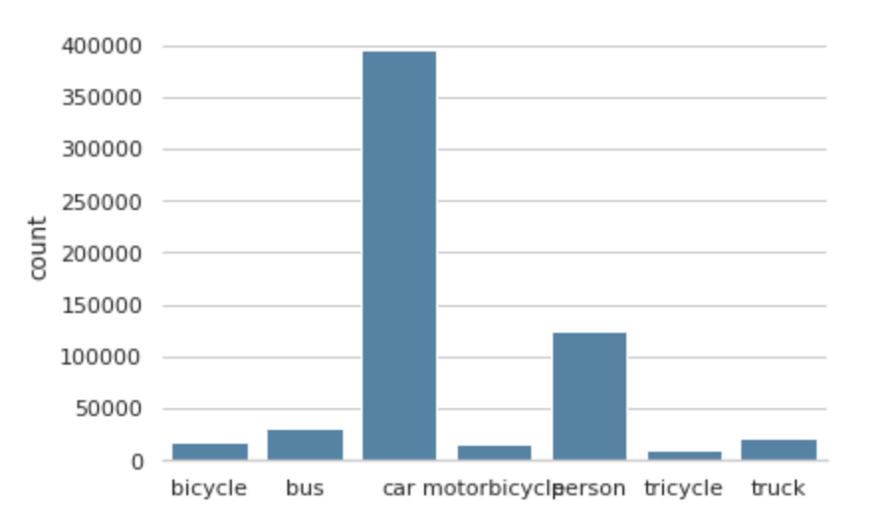
EDA: Overall View of Objects

Slide 14
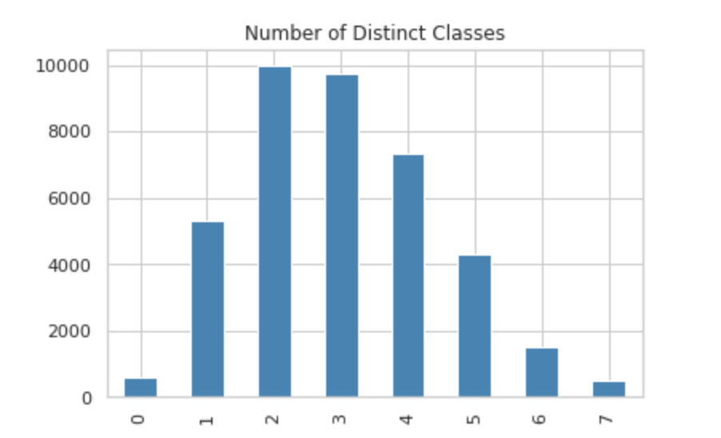
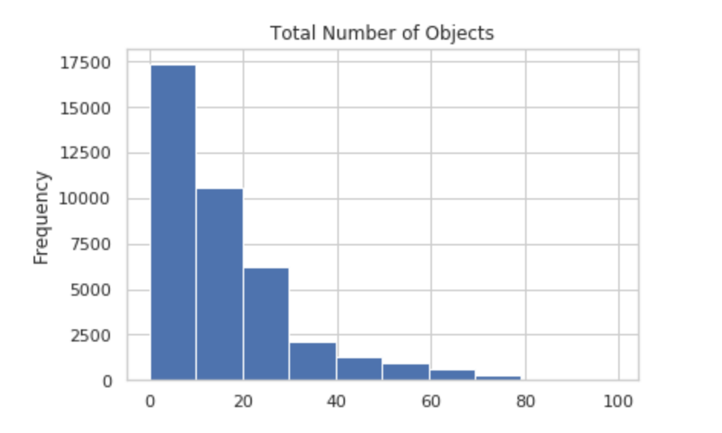
EDA: Per Image Data Distribution

Slide 15
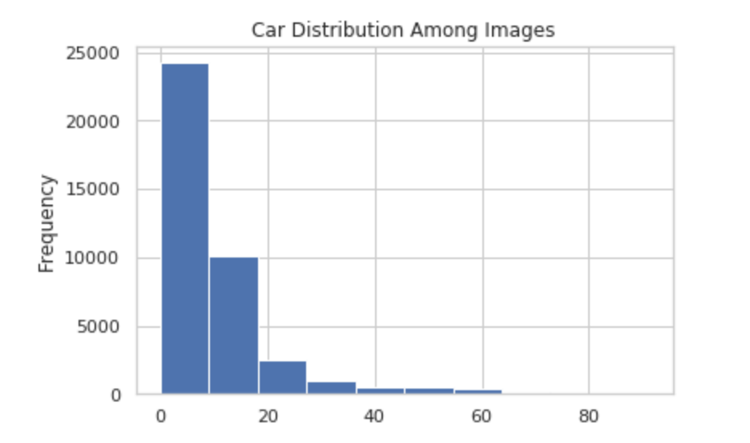
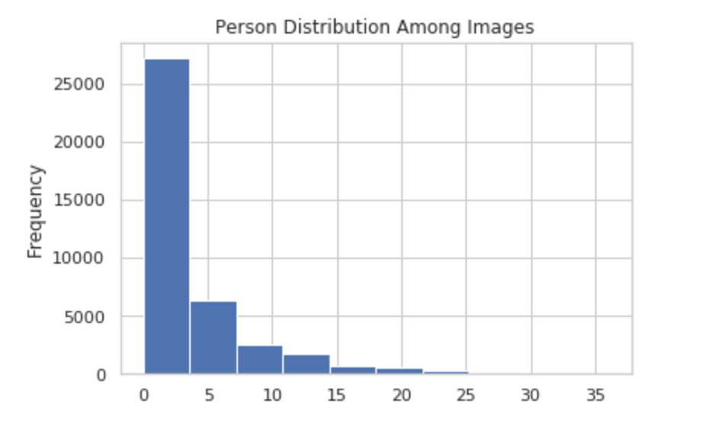
EDA: Car & Person Distribution

Slide 16
Methodologies

Slide 17
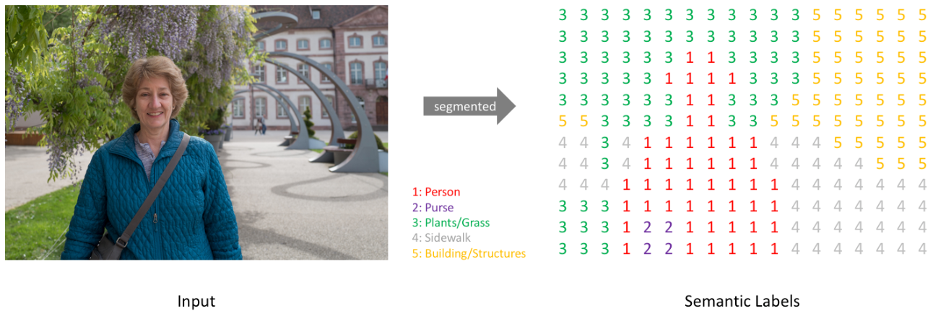
Main Idea
Scene understanding using semantic Segmentation:
Pixel by pixel
Instance segmentation
What makes this problem challenging?
Precise boundary around the object
Dense pixel wise predictions
Notes:
So in our problem, we are basically trying to perform scene understanding using semantic segmentation. Semantic segmentation is understanding an image at pixel level i.e, we want to assign each pixel in the image to a class. One of the key questions we had while beginning this project was how is this different from object detection. The idea of object detection revolves around finding an object of interest by drawing a bounding box around it. On a very basic level, we essentially divide the image into grids and pass the grid though a convolutions. After multiple passes we get a bounding box with an object inside it. Semantic segmentation is taking object detection deeper and performing a multiclass classification at the pixel level. In this we force a pixel to have only one label. Apart from recognizing the woman and the tree behind her, we also have to delineate the boundaries of each object in our image. Therefore, unlike classification, we need dense pixel-wise predictions from our models. We can see how this is very relevant to the autonomous vehicles as as full scene understanding through semantic segmentation helps in perception which helps the vehicle in making decisions. There are two types of semantic segmentation pixel by pixel and instance segmentation. We are performing pixel level segmentation.

Slide 18
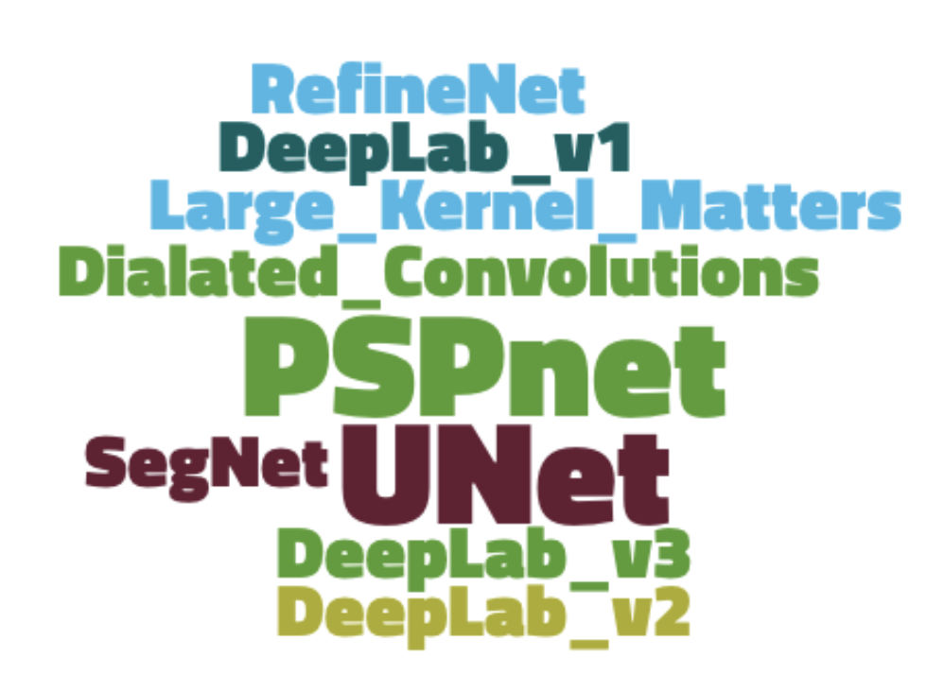
Approaches
Available algorithms
UNet
SegNet
Dilated Convolutions
DeepLab (v1 & v2)
RefineNet
PSPNet
Large Kernel Matters
DeepLab v3
Notes:
These are some of the neural net models that are used in the industry and today we will talk about UNet and PSP Net

Slide 19
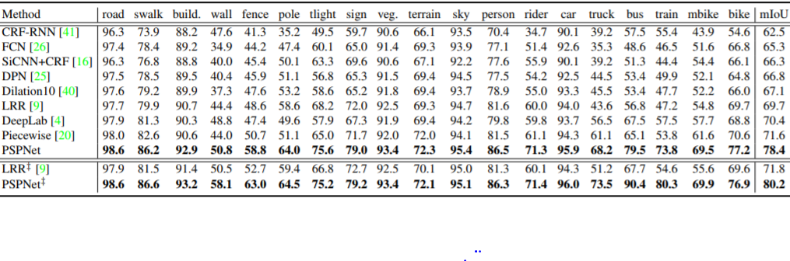
Approaches
PSP net by far has been tested on outdoor scenes datasets and performed the best

Slide 20
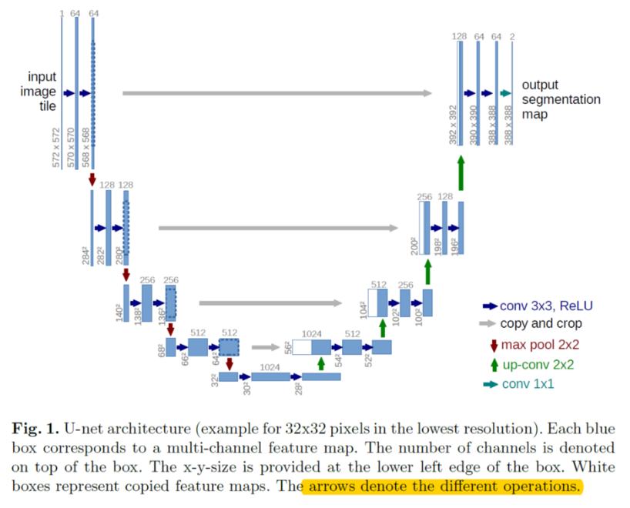
UNet
Train from scratch
UNet
UNet with ResNet50 as encoder
Notes:
UNet is one of the most popular neural networks for pixel classification. This net came into existence with an application in biomedical segmentation. It is symmetric in shape and is basically a combination of multiple convolutional and max pooling layers. The left side of the network is the contracting path or the encoder and is a standard classifier and where as we go down the network, we capture more and more information about what the object is. The right side of the network in the expansion path or the decoder where we perform upsampling. As you can see in the picture we have multiple upconvolutions. Most importantly we have grey arrows feeding in from the encoder which give important information about the features or the objects. This is what basically gives our segmentation map. We chose this as one of our main models because it is very good detecting touching objects with the same class.

Slide 21
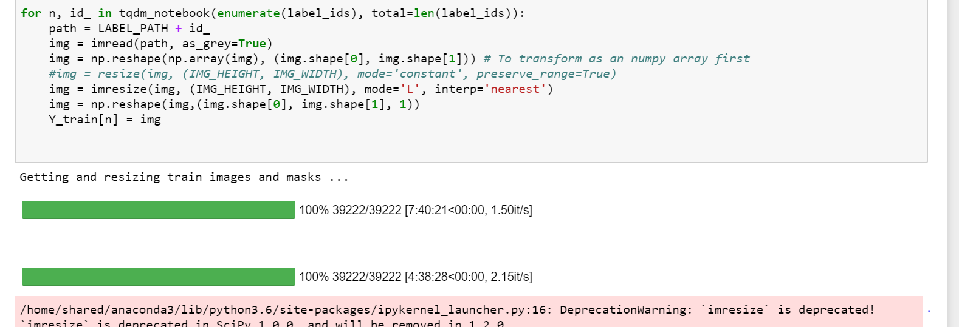
U-Net Implementation
Computational speed resizing the images before fitting to U-net.
Notes:
It took 12 hours to resize the images in the training set (train_label+train_color)

Slide 22
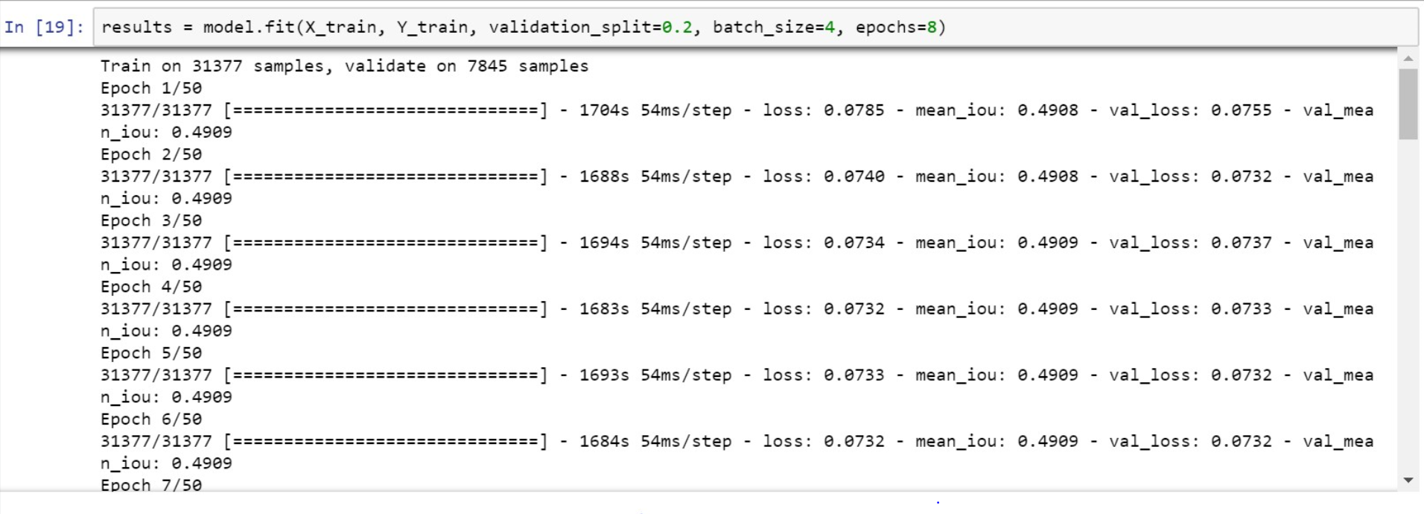
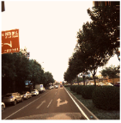
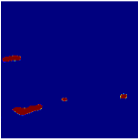
UNet Output
UNet resulting in 49% mIOU
Notes:
This is the output of the unet model that we built from scratch. The metric that we used here to evaluate our model was mean iou. This is a widely used metric for semantic segmentation problems. Iou means intersection over union. It basically measures the overlap between the target mask and our prediction output by taking the area of overlap and dividing the area of the union from both our predicted and true labels. The IOU is then aggregated over all the images to give mean IOU. I’m not sure if we can see in the picture but our mean IOU was about 0.49. We tried another unet model from scratch where we used a resnet as an encoder. ResNet is a very deep model with 152 layers and uses skip connections. These skip connections are very important because they help us in preserving spatial information which as you can imagine is very important in scene understanding. For this model, we just used binary cross entropy to calculate the loss between the predicted and the truth. Now Apoorva is going to talk about the other net that we used PSPNet.
Teeru, u can talk about mean(meanIoU) from the U-Net model was around 49%.
In essence, the intersection-over-union metrics (like mean IU) are preferred since they control for the total number of pixels for a class. Accuracy can be misleading; for example the majority of pixels might be background so that a method predicting all background will still have seemingly good performance. As a ratio IU is less susceptible to this.

Slide 23
PSP Net

Slide 24
Why PSP Net (Pyramid Scene Parsing Network)
Detects not just the object but also the “outline” of object by considering the context of the entire scene
How good is this model?
Provides a superior framework for pixel-level prediction tasks.
Cityscapes - 80.2% Accuracy
PASCAL VOC - 85.4% Accuracy
Why?
State-of-the-art Image classification uses FCN + Average Pooling
Classical scene understanding uses Spatial Pyramid Matching
For better scene recognition PSP net uses both FCN + Spatial Pyramid Matching Pooling
Notes:
https://www.kaggle.com/kmader/modeldepotio-pspnet-pretrained/home
Detects not just the object but also the “outline” of object by partitioning the image into several segments like U-net but by taking into consideration the context of the entire scene.
This aspect is extremely important specially while designing the safety features like implementing automatic braking system, lane changing, unavoidable collisions etc. which needs good precision & localisation while other neural networks tries to find the bounding boxes and then predicts the class.
PSPnet is one of the most trending next to Deep_Lab NN particularly in the area of semantic segmentation, which is why we decided to go ahead with this model.
PSPNet provides a superior framework for pixel-level prediction tasks. The proposed approach achieves state-of-the-art performance on various datasets. It came first in ImageNet 2016 scene parsing challenge, PASCAL VOC 2012 benchmark and Cityscapes benchmark. A single PSPNet yields the new record of mIoU accuracy 85.4% on PASCAL VOC 2012 and accuracy 80.2% on Cityscapes.

Slide 25
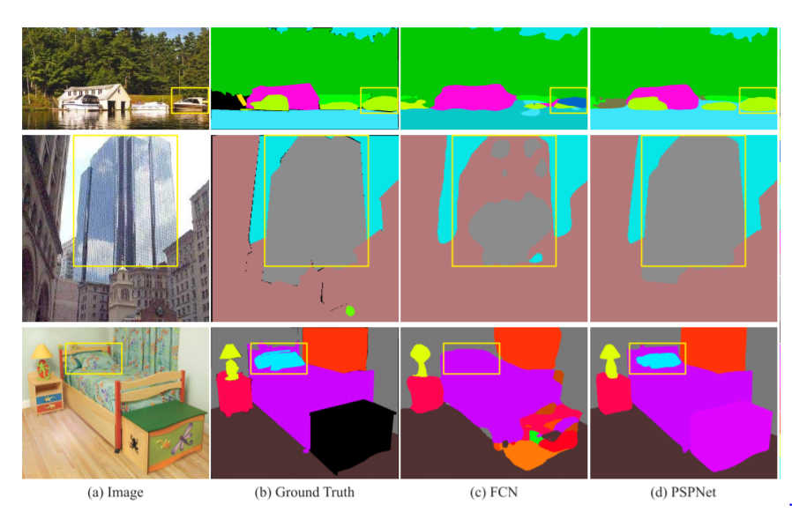
PSP Net Performance
Ref:https://arxiv.org/pdf/1612.01105.pdf
Notes:
the problem with usual Fully connected neural nets
all output neurons are connected to all input neurons. This kind of architecture can’t be used for segmentation, if you are working in a huge space of possibilities (e.g. unconstrained real images. Same FC activations may not be sufficient to correctly predict the segmentation. Some of the common problems that we see with FCNs are
1)Similar shaped objects
2)Confusion categories like building vs sky scrapper, wall and house
3)not clearly visible objects i.e. matching with the background
To summarise, these kind of errors can be reduced if we have info on global scene level priors
and PSPnet tries to solve these 3 major problems with spatial pyramid matching pooling
So let’s move on to what’s happening inside PSP net

Slide 26
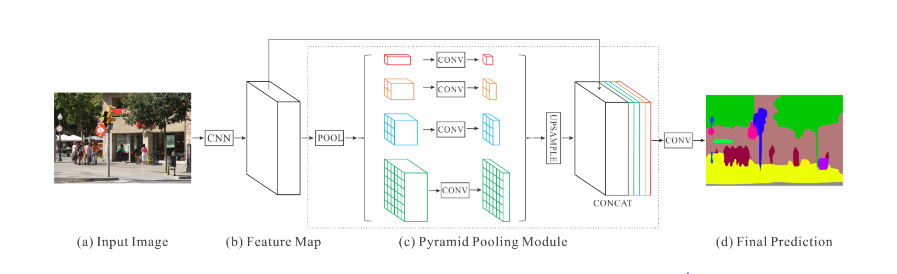
Learning with PSP Net
CNN: Feature map of the last convolutional layer
Pyramid pooling module: Harvest different sub-region representations, followed by upsampling and concatenation layers to form the final feature representation (carries both local and global context information)
Convolution layer: Final per-pixel prediction
Ref:https://arxiv.org/pdf/1612.01105.pdf
Notes:
Captures the detailed outline from the pyramid pooling module in the middle which fuses features under four different pyramid scales.
PSP Net’s first step i.e. feature map is obtained from a pretrained ResNet [13] model.
On top of this map, the pyramid levels are built to gather information # separates the feature map into different sub-regions and forms pooled representation for different locations
And these 4-level pyramid poolings cover the whole, half of, and small portions of the image for different locations
Then we directly upsample the low-dimension feature maps that gives global priors to get to the same size feature as the original feature map via interpolation methods
These scaled features are added to original feature map and final predictions are made.
###not included
Our global prior representation is effective to produce good quality results on the scene parsing task, while PSPNet provides a superior framework for pixellevel prediction.
This framework started off with scene parsing task that are mostly based on the fully convolutional network (FCN) . We found that the major issue for current FCN based models is lack of suitable strategy to utilize global scene category clues i.e. the sometimes if the shape is similar, then it misclassfies things like it could misclassify boat as a car but given that the overall scene is a boathouse, then it should predict correctly. These error/flaws in FCN with max pooling motivate proposal of our pyramid pooling module as the effective global context prior. So the middle layer pyramid scene parsing network (PSPNet) does exactly the same. It extends the dilated FCN for pixel prediction, we extend the pixel-level feature to the specially designed global pyramid pooling one.

Slide 27
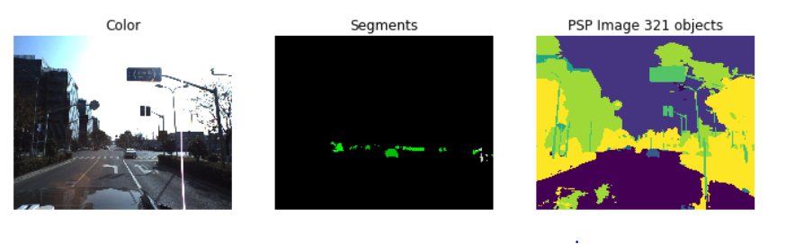
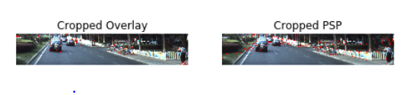
PSP Net Output ( all classes included)
Notes:
Ref:https://arxiv.org/pdf/1612.01105.pdf

Slide 28
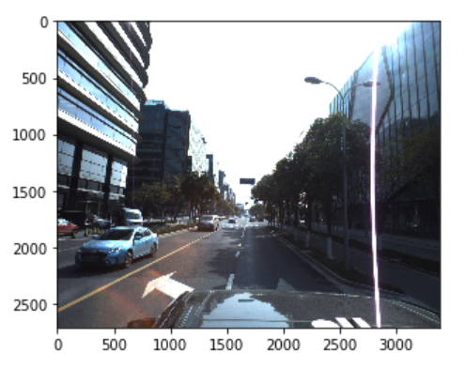
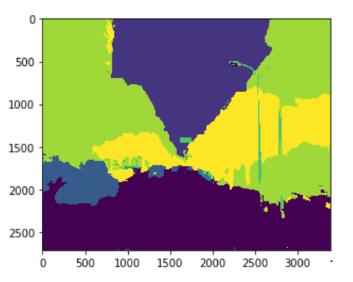
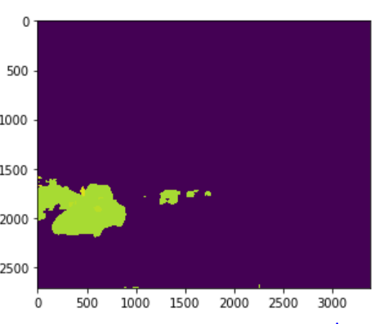
Accuracy (only 7 classes included)
94% accuracy
Notes:
Ref:https://arxiv.org/pdf/1612.01105.pdf
Coming to the implementation part, we basically used the weights from the PSP net obtained from similar driving images dataset called Cityscapes on which it was giving a good accuracy and tested it on couple of our images and the accuracy was coming out to be great.
And currently we are in the process of implementing transfer learning but because this model is new and not yet integrated with Keras application, the usually inbuilt functions to access checkpoints and weights, accuracy calculations are not that straight forward in our case. Once it’s done we’ll be putting the results on our blog
Now Pooshan will take over and summarise. Thank you.

Slide 29
Challenges

Slide 30
Challenges
Resources
Pixel by Pixel v.s. Object Detection
No full functioning code
Unable to replicate results
Transfer Learning (PSPNet)
Not integrated in Keras
Accessing weights
Calculating overall model accuracy

Slide 31
Next Steps
Dataset (Cityscapes) → Model instead of Model → Dataset
Improve accuracy of UNet model and optimize preprocessing
Implement full transfer learning for PSPNet
Future → DeepLab Implementation

Slide 32
References
http://blog.qure.ai/notes/semantic-segmentation-deep-learning-review#pspnet
https://arxiv.org/pdf/1612.01105.pdf
https://www.youtube.com/playlist?list=PL3FW7Lu3i5JvHM8ljYj-zLfQRF3EO8sYv
https://www.kaggle.com/kmader/data-preprocessing-and-unet-segmentation-gpu
https://www.kaggle.com/kjeanclaude/wad-video-full-implementation-atoz-tfkeras
https://www.tecmint.com/keep-remote-ssh-sessions-running-after-disconnection/
http://cs231n.github.io/gce-tutorial/
https://www.youtube.com/watch?v=ArPaAX_PhIs&list=PLkDaE6sCZn6Gl29AoE31iwdVwSG-KnDzF
https://lmb.informatik.uni-freiburg.de/people/ronneber/u-net/
https://www.kaggle.com/kmader/pretrained-pspnet-on-driving-scenes/notebook
https://www.kaggle.com/c/cvpr-2018-autonomous-driving

Slide 33
THANK YOU!
Any questions?

